Slide 1
Yahtzee-AI
Rui Tang, Yingshu Wang, Aman Verma

Slide 2
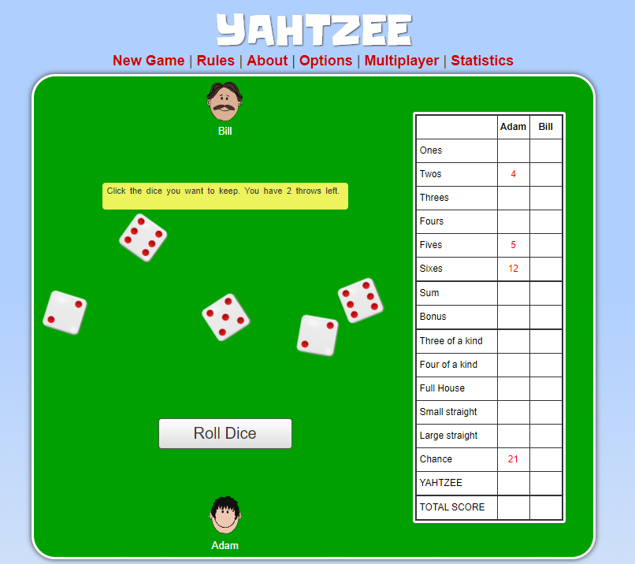

Slide 3
Our goals:
•Maximize the score (Casino)
•Reduce the complexity as much as possible (Tutorial, Guidlines...)
•Generalize to other scenarios

Slide 4
Difficulties:
•Random process
•Complex Status
•State Space
•Confronting

Slide 5
Data source
•Actually we don’t need data source
•Generated data by random generator

Slide 6
Method:
Reinforcement Learning
Parallel processing

Slide 7
Our Future:
Improve the win rate in multiple player games
Solve more complicated Game like Texas Poker
Find a way to find Nash Equilibrium

